Slide 1
  Core Java
  Collections in Java
LEVEL – PRACTITIONER

Slide 2
Objectives
After completing this session, you will be able to :
  Define Collections
  Describe usage of collections
  Describe the benefits of collections
  Understand the core Collection Interfaces
  Understand the implementations

Slide 3

What are Collections?
What is a collection?
  A “collection” is a container that groups multiple elements into a single unit.
Elements
1…n
Collection
In java world, a collection represents a group of objects, known as elements.

Slide 4
Collections Framework
What is a collections framework?
  A collections framework is a unified architecture for representing and manipulating varieties of collections.
  Some collections allow duplicate elements and others do not.
  Can be used only to hold object type data (non – primitive type).
  Some are ordered and others are unordered.
  The collection framework is available in the java.util package.
  Collection framework contains,
    A set of Interfaces.
    Concrete class implementations for the interfaces.
    The classes in turn has standard API’s for processing collections.

Slide 5
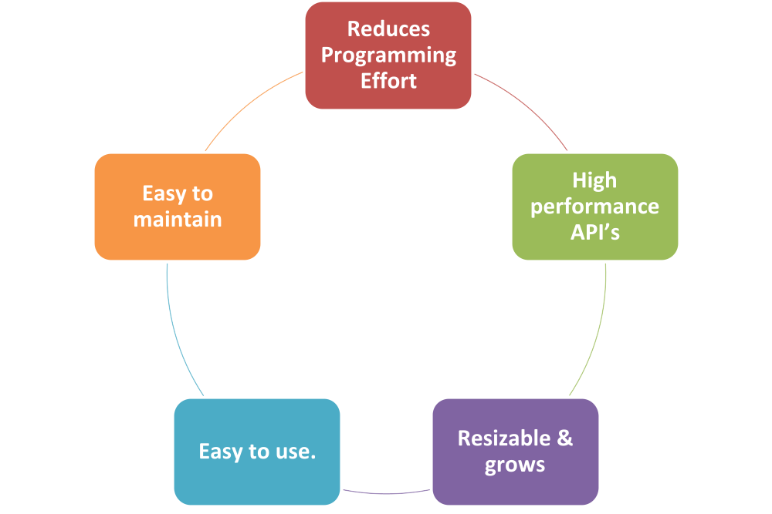
Benefits of Collection framework
Example: This provides methods for sorting which need not be developed, from scratch thus reducing the development effort.
Collection Framework Benefits
The API’s are easy to use and maintain.
Example: The API’s provided are proven tested ones with high performance.
Example: The collection sizes dynamically changes that is it gets shrunk or increased based on the elements stored.

Slide 6
Collection Interfaces
What are collection Interfaces?
These are set of predefined java interfaces defined in java.util package which can be used for performing any logic related to collection of Objects.
Example: Set, List, Map
What are collection Implementations?
These are predefined classed which implements one of the collection interfaces. The programmer uses these for processing collection of Objects.
Example: ArrayList, HashMap.

Slide 7
Sorted Vs Ordered Collection
Consider you have a collection country names.
India
Australia
England
New Zealand
South Africa
Problem 1 : You need to insert the above list of countries in the same order given above . What type of collection can be used ?
Solution : Any ordered collection can be used. Example: List.
Problem 2: Suppose you want to automatically sort the country names and store it in a collection ? What type of collection can be used ?
Solution : A sorted collection like SortedSet can be used which automatically sorts and rearranges the value each time a new country is added to the list.
A SortedMap is a Map that maintains its entries in ascending order, sorted based on the key

Slide 8





Collection Framework Components
The root interface in the collection hierarchy.
This is an interface.
An ordered collection which contain duplicate elements.
Collection
List
Set
This is an interface.
A collection that cannot contain duplicate elements.
Vector
Array List
Hash Set
Tree Set
Vectors can hold duplicate values.
This is thread safe.
Cat | Dog | Bat | Bat | Lion | Cat | Lion | Bird
Array List can hold duplicate values.
This is not thread safe.
Can hold null values.
Allows null.
Does not allow duplicate values.
Allows entries to be sorted in a specific order.
Cat | Dog | Bat | Lion | Bird

Slide 9
Difference between Set and List
List :
Cat | Dog | Bat | Bat | Lion | Cat | Lion | Bird
null | null
It allows duplicates
It permits multiple null values.
Set:
Cat | Dog | Bat | Lion | Bird | null
It does not allow duplicates
Only one null value is permitted

Slide 10

Time To Reflect
Associates to reflect the following before proceeding.
What is the collection type that can be used to hold duplicate values?
What type of collection can be used for thread safe storage of elements with duplication?
What type of collection can be used to store unique elements in a sorted order?

Slide 11
Collection Interface
The root interface in the collection hierarchy.
JDK does not provide any direct implementations of this interface, it provides implementations of more specific sub-interfaces like Set and List etc.
Contains methods which needs to implemented directly or indirectly by the sub classes.
For more details on the methods specified in Collection interface refer, http://docs.oracle.com/javase/6/docs/api/java/util/Collection.html

Slide 12
List Interface
Used for storing the elements in a ordered way.
Supports duplicate entries.
Supports index based additions and retrieval of items.
List implementations:
Vector
ArrayList
LinkedList
We will be covering only ArrayList implementation in details. For details on the other List Implementations refer
LinkedList- http://docs.oracle.com/javase/6/docs/api/java/util/LinkedList.html.
Vector - http://docs.oracle.com/javase/6/docs/api/java/util/Vector.html.

Slide 13
Array List
Implements List interface
ArrayList can grow and shrink in size dynamically based on the elements stored hence can be considered as a variable array.
Values are stored internally as an array hence random insert and retrieval of elements are allowed.
Can be traversed using a foreach loop, iterators, or indexes.
Initially gets created with an initial capacity , when this get’s filled the list automatically grows.
Can hold only object type data – Cannot hold primitive type values.
Supports duplicate entries.

Slide 14
Important ArrayList methods
Method | Description
void add(int index, Object element) | Inserts the specified element at the specified position in this list.
boolean add(Object o) | Appends the specified element to the end of this list.
boolean addAll(Collection) | Appends all of the elements in the specified Collection to the end of this list, in the order that they are returned by the specified Collection's Iterator.
boolean addAll(int index, Collection c) | Inserts all of the elements in the specified Collection into this list, starting at the specified position.
void clear() | Removes all of the elements from this list.
boolean contains(Object elem) | Returns true if this list contains the specified element.
Object get(int index) | Returns the element at the specified position in this list.

Slide 15
Important ArrayList methods
Method | Description
int indexOf(Object elem) | Searches for the first occurrence of the given argument, testing for equality using the equals method.
int lastIndexOf(Object elem) | Returns the index of the last occurrence of the specified object in this list.
Object remove(int index) | Removes the element at the specified position in this list.
void removeRange(int fromIndex, int toIndex) | Removes from this List all of the elements whose index is between fromIndex, inclusive and toIndex, exclusive.
Object set(int index, Object element) | Replaces the element at the specified position in this list with the specified element.
int size() | Returns the number of elements in this list.
Object[] toArray() | Returns an array containing all of the elements in this list in the correct order.
http://docs.oracle.com/javase/1.4.2/docs/api/java/util/ArrayList.html

Slide 16
How to Create an Array List ?
ArrayList can be created by using any of the three possible constructors given below
ArrayList() : Constructs an empty list.
ArrayList(Collection c) : Constructs a list from an existing collection, containing the elements of the specified collection.
ArrayList(int initialCapacity) : Constructs an empty list with the specified initial capacity.
Syntax :
List listName=new ArrayList();
Example :
List mylist=new ArrayList();
Why ArrayList object is declared as the interface type List?

Slide 17
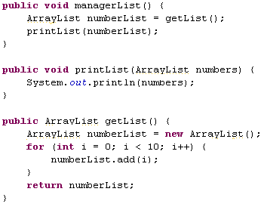
Need for declaring using interface type?
Consider the code below what happens if the ArrayList API becomes deprecated ? How many changes should be done in the below code ?
All the red boxes are changes to be done.
Lets see how to reduce it.

Slide 18
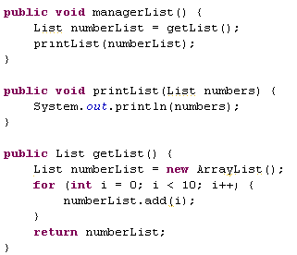
Need for declaring using interface type? (Cont)
The solution is declaring the reference variable as the interface type rather than of the implementation type. Example all the list objects can be declared using List type.
Now change needs to be done in one place, where the object is created.

Slide 19
How to add elements in a ArrayList?
Values can be added to an ArrayList using any of the add methods.
Syntax :
listName.add(element);
Example :
Create an arraylist
0
1
2
3
4
5
6
List myList=new ArrayList()
Apple | Orange
Apple | Lemon | Orange
banana | Lemon | Orange
myList.add(“Apple”);
myList.add(“Orange”);
Adds the element lemon at position 1 moving orange to position 2.
Adds elements one by one to the list.
myList.add(1,”lemon”);
When set is used the item in the particular index will be replaced by the new item.
myList.set(0,”banana”);

Slide 20
Lend a Hand - ArrayList
Objective: In this lend a hand we are going to learn about creating and adding elements into the array list.
Problem Statement 1: Create a method that accepts the names of five countries and loads them to an array list and returns the list.
Problem Statement 2 : Create an method which can return an array list holding values 1-10.
Problem Statement 3 : Create a method needs to return an array list holding value 1-15. The method should make use of the already created array list containing values up to 10 and then add values from 11-15 using a for loop.

Slide 21
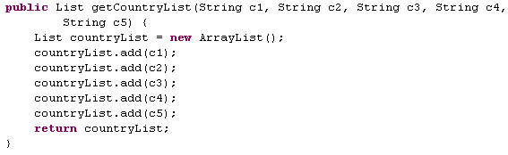

Lend a Hand Solution – Problem Statement 1
Create a class named ArrayListEx and develop the method as mentioned below and from the main method trigger this method and check the output.
Creates an array list object and adds the country names to it.
Always remember to declare the list using List interface.

Slide 22
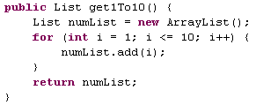
Lend a Hand Solution – Problem Statement 2
Add the following method in the ArrayListEx class and from the main method trigger this method and check the output.
Note: When a primitive is added to a collection it gets automatically converted to its equivalent wrapper object and loaded in the list.

Slide 23
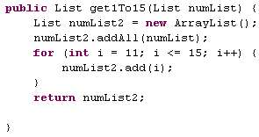
Lend a Hand Solution – Problem Statement 3
Add the following method in the ArrayListEx class and from the main method trigger this method and check the output.
The list returned by the previous problem statement should be passed as and input to this method.
addAll () method adds the entire list to the new list

Slide 24
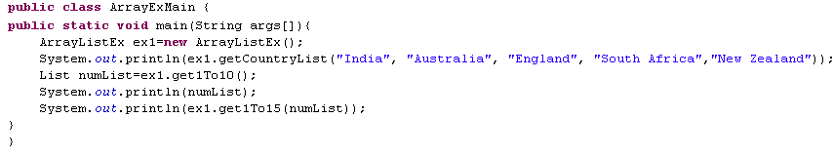
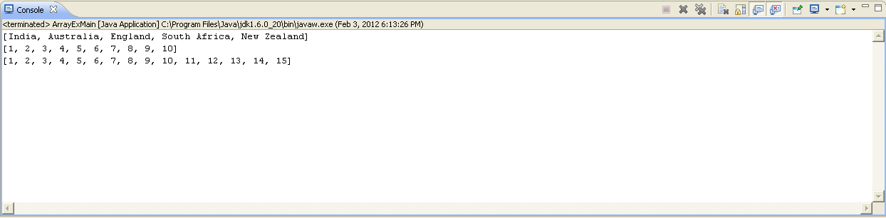
Lend a Hand Solution – Run the program
Create a Main Class and execute the methods.
Output

Slide 25
Set Interface
  The Set interface is a collection that cannot contain duplicate elements.
  It permits a single element to be null.
  Set interface contains methods inherited from collection interface.
  Sorted Set interface is a set that maintains its elements in ascending order.
  Set Implementations:
  HashSet
  TreeSet
We will be covering only HashSet in detail in this session. For details on TreeSet visit http://docs.oracle.com/javase/1.4.2/docs/api/java/util/TreeSet.html

Slide 26
HashSet
Implements the Set interface hence doesn’t support duplicate entries.
Does not support random access or retrieval.
Cannot predict the order in which the items get stored in the Set.
Not Thread safe.
Permits Null value(Only one).

Slide 27
How to create an HashSet ?
HashSet can be created by using the following syntax
Set setName=new HashSet();
Example :
Set countries=new HashSet();

Slide 28
Important Methods in HashSet
Method | Description
boolean add(Object element) | Adds the specified element to this set if it is not already present.
void clear() | Removes all of the elements from this set.
boolean contains(Object o) | Returns true if this set contains the specified element.
boolean isEmpty() | Returns true if this set contains no elements.
Iterator<E> iterator() | Returns an iterator over the elements in this set.
boolean remove(Object o) | Removes the specified element from this set if it is present.
int size() | Returns the number of elements in this set.
http://docs.oracle.com/javase/1.4.2/docs/api/java/util/HashSet.html

Slide 29
How to add elements to HashSet?
Elements can be added one by one using a add() method or an entire collection can be added using the addAll() method.
Example:
mySet.add(“India”);
mySet.add(“Australia”);
mySet.add(“India”)
mySet.addAll(mySet1);
Adds two elements into the set.
Returns false since India already exists in the set.
Adds all the items of Set mySet1 to mySet
Note : If an entire set is added to another set , the duplicate elements will not get added.

Slide 30
Lend a Hand - HashSet
Objective: Let us learn how to create a HashSet and add elements into it.
Problem Statement 1: Create a method that accepts the names of five countries and loads them to an HashSet and returns the Set.
Problem Statement 2 : Create an method which can return a set holding values 1-10.
Problem Statement 3 : Create a method needs to return a set holding value 1-15. The method should make use of the already created set containing values up to 10 and then add values from 11-15 using a for loop.

Slide 31
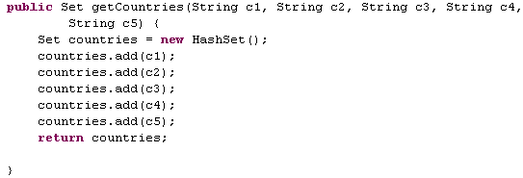
Lend a Hand Solution – Problem Statement 1
Create a class SetEx, add the below method to the class. Invoke the method from a main method and test the method.
Always remember to declare the collection using the appropriate interface. In the example it is Set.

Slide 32
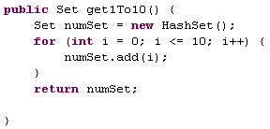
Lend a Hand Solution – Problem Statement 2
Add the below method to the SetEx class. Invoke the method from a main method and test the method.
Note: When a primitive is added to a collection it gets automatically converted to its equivalent wrapper object and loaded in the list.

Slide 33
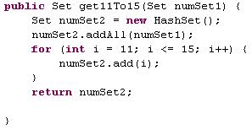
Lend a Hand Solution – Problem Statement 3
Add the below method to the SetEx class. Invoke the method from a main method and test the method.

Slide 34
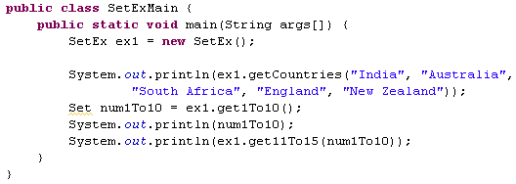
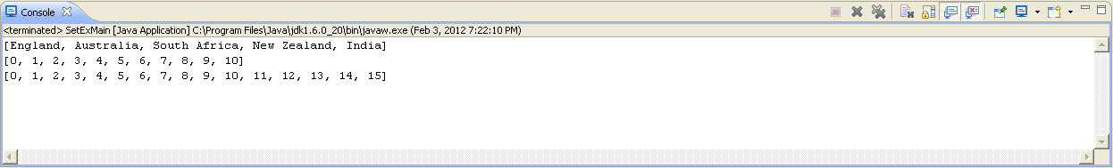
Lend a Hand Solution – Main Class
Create a main class as given below and execute it.
Output

Slide 35

Time To Reflect
Associates to reflect the following before proceeding.
What method can be used to merge to two array lists ?
What happens when a duplicate entry is tried to be added to a set ?
What is the difference between add and set method in arraylist?
How to add an element to a particular position in an array list?

Slide 36

Let us now learn about “Generics”

Slide 37



Real World Example
Let us take a real time example
The buyer does not know what these red shape boxes contain. Hence the buyer needs to open these boxes every time to find what is inside it
Roses
Jewels
Chocolate
Here, the buyer is aware of what is inside the boxes ,since the box is labeled. This makes his job easier since he knows what he can put in and what he can take out from the box

Slide 38
How to identify data type in a collection?
Similar to the boxes how can one know what is the data type of the element stored in a collection?
Generics is the solution.

Slide 39
What is Generics?
Generics is a feature allows the programmer to specify the data type to be stored in a collection or a class when developing the program.
Compile throws error if the data stored is different from the data type specified in the generic.

Slide 40
Let’s Analyze Generics Programmatically.
We will take the same box example but instead of jewels , chocolates and roses we will store java objects inside it. Consider a Box class,
public class Box
{
  private Integer width;
  public void addWidth(Integer width) {
  this.width = width;
  }
  public Integer getWidth() {
  return width;
  }
}
Assume that I have to pass width as a Float (or) Double to the Box class. How can I achieve this?
Generics is the solution.

Slide 41
Generics solves the problem.
We will modify the Box class with generics as shown below.
public class Box<Type> {
  // T stands for "Type“
  private Type width;
  public void addWidth(Type width) {
  this.width = width;
  }
  public Type getWidth() {
  return width;
  }
}
As shown in the example Type refers to the data type of the “width” field which is declared as generic argument of the class. Instead of declaring “width” as Integer we have declared as a generic data type “Type”. When declaring Box object, we can pass any data type for Type which affects all the Type declarations inside the class.
Example: Box<Float> will declare a box object whose width field data type is “Float”
An object can created as
Box<Float> box=new Box<Float>();
By doing this we can ensure the same Box behaving differently for different data type.

Slide 42

Generics usage in Collections
Collections declared with generic (data type) ensures that the collections hold only elements of particular data type.
Java collections have been defined with generics for it accept objects of any data type.
Example: Java ArrayList class is defined with a generic as shown below depicting that the collection can accept generics with any data type.

Slide 43
Using Generics With Collection
We can declare collection to hold a specific data type elements using generics .
Syntax:
InterfaceName <Type> varName=new Implementation<Type>();
Example : Declares an array list for holding only integer values.
List<Integer> myList=new ArrayList<Integer>();

Slide 44
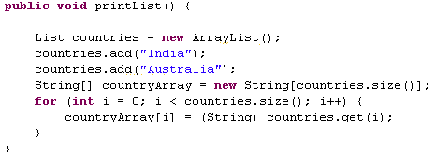
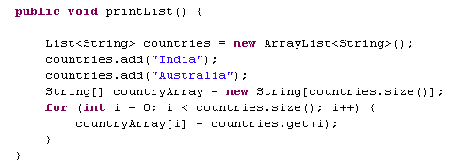
Advantages of using Generics with Collection
Avoid unnecessary type casting : Using generics avoid the need of typecasting while retrieving the elements from the collection.
Consider an ArrayList named countries ,elements can be retrieved from the List as shown below
Without Generics
With Generics
Type Casted to String
No need of type casting

Slide 45
Advantages of using Generics with Collection
Minimize CastException during run time: For example assume a method returns a List of integers. The client is unaware about the type of data held by the collection and he may type cast it to some incompatible type and end up in CastException during runtime. In case of any invalid casting compiler will throw an error..
Easy Maintenance & Readability : Looking at the code the developer can easily know the data type stored in the collection and thus helps him to process the collection easily.

Slide 46
Lend a Hand- Generics
Objective: Let us learn how to declare/process collections declared with generics.
Problem Statement 1 : Create a method which can accept a collection of country names and add it to ArrayList with generic defined as String and return the List.
Problem Statement 2 : Create a method which can create a HashSet containing values 1-10. The Set should be declared with the generic type Integer. The method should return the Set.

Slide 47
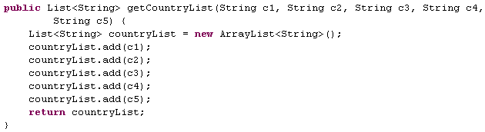
Lend a Hand – Solution Problem Statement 1
Create a class named GenericEx and add the method given below.
Generic Declaration
Try to add a Integer number to the List and see how the program behaves.

Slide 48
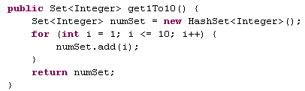
Lend a Hand Solution – Problem Statement 2
Add the below method to GenericEx class.
Generic Declaration

Slide 49
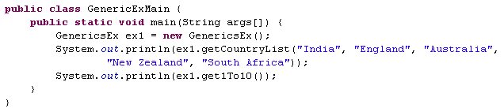
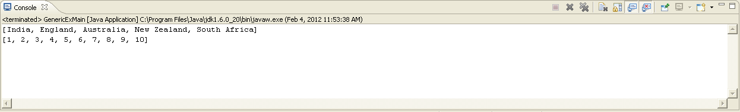
Lend a Hand – Main Class
Create a class named GenericExMain with a main method
Output

Slide 50
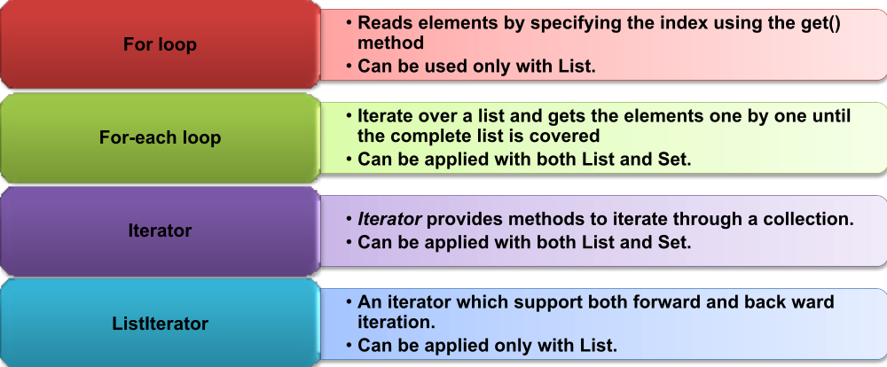
How to Iterate Through Collection Elements ?
Let us now see how to iterate through the collection and read elements one by one.
The following are the ways to iterate through a collection

Slide 51
Lend a Hand – Iterating Collection
We will go through each of the iteration mechanism using a lend a hand example.
We will reuse the classes we developed as part of the previous lend a hand,
  ArrayListEx
  SetEx

Slide 52
Lend a Hand :For Loop
Objective: We will learn how to the iterate through the List objects using a for loop.
Create a class with a main method which reads the lists from the ArrayListEx and iterates through the list.
Problem Statement 1 :
The main method should read the country list and read it one by one , store in a String object and print the country names in separate lines.
Problem Statement 2:
The main method should retrieve the list of numbers from 1-10 using the get1To10 method in ArrayListEx class and find the sum of numbers in the list and print the sum.

Slide 53
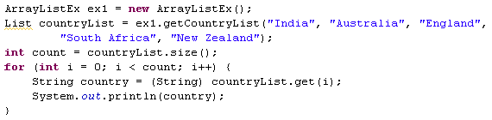
Lend a Hand– Problem Statement 1
Create a class named ForLoopExMain with a main method. Add the following lines of code inside main method which can read the Country list from ArrayListEx and print it.
Reads the size of the list
The for loop iterates from 0 to size-1 and reads elements one by one.
Note : Since Generics is not used, we can see that elements are explicitly casted to String type.

Slide 54
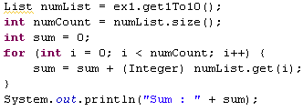
Lend a Hand Solution – Problem Statement 2
Add the following lines of code inside the main method to read the number list from ArrayListEx and calculate the sum of all the numbers in the list.

Slide 55
For-Each loop
For each loop was added as a part of java 5
Can be used to read elements from a collection or array
The advantage of “for each” is that we don’t need to specify the index. It automatically iterates over the specified object and reads values one by one.
Syntax :
for(datatype variableName : collectionName){
loop body
}
Example
for(Object a : myList){
System.out.println(a);
}
Reads each element of the collection collectionName with the type datatype and assigns it to the variable variableName one by one.
Reads elements as objects one by one from the list “MyList” and assign to the variable a.

Slide 56
Lend a Hand – for Each loop
Objective: We will learn how to use for each loop for iterating through Sets.
We will use the Set created in SetEx class which we developed in our previous lend a hand. Create a class named ForEachExMain with a main method which iterates through the Set.
Problem Statement 1 : The main method should read the set of countries returned by getCountries() method in SetEx class and print the names of countries in separate lines.
Problem Statement 2 : The main method also should calculate the sum of numbers in the set returned by the get1To10() method in the SetEx class.
Prerequisite: Declare the Sets with respective generic types. The getCountries() method should return a Set with String generic type and get1To10() method should return an Set with generic type Integer.

Slide 57
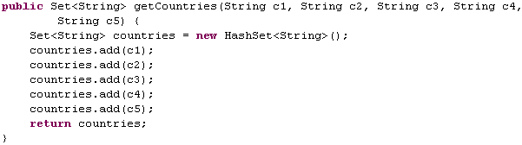
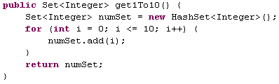
Lend a Hand :For Each loop
Adding generics to the collections of getCountries() and get1To10() methods.

Slide 58
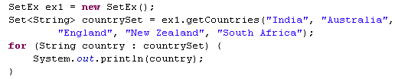
Lend a Hand Solution – Problem Statement 1
Create a class named ForEachExMain with a main method
Add the following lines of code to read the countries set from the SetEx class and iterate using for each loop and print it.

Slide 59
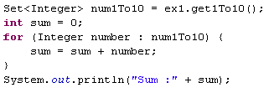
Lend a Hand – Problem Statement 2
Add the following lines of code to the main method to find the sum of numbers in the number set read from the SetEx class

Slide 60
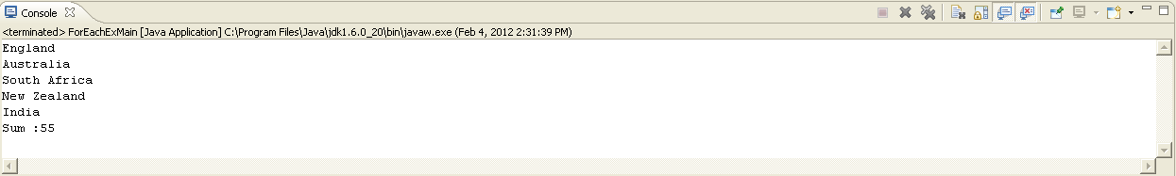
Lend a Hand – Execute the main class
Run the class ForEachExMain

Slide 61
Iterator
What is an Iterator interface?
  This interface contains methods which is used for iterating & accessing all the elements of a collection in sequence.
  The List and Set collections can be iterated using iterators.
  Iterator interface methods:
Method | Description
boolean hasNext() | true if there are more elements for the iterator.
Object next() | Returns the next object or elements.
void remove() | Removes the element that was returned by next from the collection. This method can be invoked only once per call to next .

Slide 62
How to Create an Iterator?
An Iterator is created for a particular collection object by calling the iterator() method on the collection object.
Syntax : Iterator<type> iteratorName=collection.iterator();
Where type is the generic type of the Iterator
Example : Creates an iterator to iterate the elements of the myList containing Integer objects.
Iterator<Integer> myListIterator = myList.iterator();

Slide 63
How an iterator works?
Working of Iterator
it.hasNext()
it.hasNext()
it.hasNext()
it.hasNext()
Iterator<Integer> it=myList.iterator();
It.next()
It.next()
It.next()
No element, hence loop terminated
Iterator Object created
The next element is retrieved everytime ‘it.next()’ is executed.
The hasnext() method is used for verifying the existence of
element in the collection before firing the next().

Slide 64
Steps for using Iterator
Step 1 : Create Iterator object
Iterator<Integer> iterator=myList.iterator();
Step 2 : Check whether next element exist using the hasNext() method
while(iterator.hasNext()) {
// Read Elements
}
Step 3 : Read the element using the next() method.
while(iterator.hasNext()) {
int number=iterator.next();
}

Slide 65
Lend a Hand Iterator
Objective: We will learn how to use an Iterator to iterate through a Set. We will use the SetEx class developed in the previous lend a hand for this demo. The Sets in the SetEx class is expected to be declared using generics..
Problem Statement : Iterate through the countries (Set) returned by the getCountries() method of the SetEx class and print the country names one by one.

Slide 66
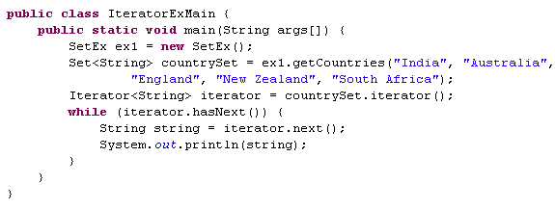
Lend a Hand – Iterator Solution.
Create a class named IteratorExMain as shown below.
Create an iterator to work on the set
Invoke the hasNext() method to check whether the iterator contains elements to be read.
Invoke the next() method to read each country from the Set.
Note :The Iterator is also declared with generics to avoid type casting.

Slide 67
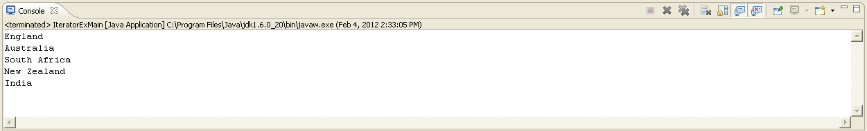
Lend a Hand – Execute the main method
Run the class named IteratorExMain

Slide 68
ListIterator
An list iterator can be used by programmer to traverse the list in either direction, modify the list during iteration, and obtain the iterator's current position in the list.
A ListIterator has no current element; its cursor position always lies between the element that would be returned by a call to previous() and the element that would be returned by a call to next().
Note : In projects Iterator interface are used commonly. So we are not going to learn the implementation of ListIterator. Associates can refer to the oracle documentation for more details on ListIterator.

Slide 69
Time To Reflect
Associates to reflect the following before proceeding.
How to make a collection accept only Integer objects?
What are all the methods available to iterate through a Set?
Can a ListIterator be used with a Set?
Which iterator can be used to add elements to a list in between the iteration process?
What may be the reason that for loop is not used to iterate through set?

Slide 70
Maps
Map stores Elements as key – value pairs.
Each key maps to one value stored in the map.
The values can be accessed by passing the key.
The key should be unique used to identify the value.
The key and value can only be objects.
Key | Value
1 | India
2 | Australia
3 | England
4 | South Africa
5 | New Zealand

Slide 71



Map Interfaces
A Map is an object that maps keys to values
Map
Hash Map
Hash Table
Tree Map
Can contain null values.
Not Thread Safe
Cannot contain null values.
This is Thread Safe
Stores in sorted order according to the key
Not Thread safe.
Key | Value
C | Cat
D | Dog
B | Null
A | Null
E | Bird
Key | Value
C | Cat
D | Dog
B | pigeon
A | cow
E | Bird
Key | Value
A | Null
B | Null
C | Cat
D | Dog
E | Bird

Slide 72
Difference between Collection interfaces and Map
Collection
Map
Cat | Dog | Bat | Lion | Bird
Key | Value
C | Cat
D | Dog
B | Bat
L | Lion
Bi | Bird
How Lion look up happens?
In the case of collection we can see that the search traverses across the entire collection to get the required object. But in the case of map it is directly accessed using the key.

Slide 73
Map Interface
Map interface is the root interface in the map hierarchy
All map implementations should implement this interface directly or indirectly.
Important Methods:
Methods | Description
void clear() | Removes all mappings from this map (optional operation).
boolean containsKey(Object key) | Returns true if this map contains a mapping for the specified key.
boolean containsValue(Object value) | Returns true if this map maps one or more keys to the specified value.
Set entrySet() | Returns a set view of the mappings contained in this map.
Object get(Objectkey) | Returns the value to which this map maps the specified key.
boolean isEmpty() | Returns true if this map contains no key-value mappings.

Slide 74
Map Interface – Important Methods(Cont)
Method | Description
Set keySet() | Returns a set with all the keys contained in this map.
Object put(Object key, Objectvalue) | Associates the specified value with the specified key in this map.
void putAll(Map t) | Copies all of the mappings from the specified map to this map
Object remove(Object key) | Removes the mapping for this key from this map if it is present
int size() | Returns the number of key-value mappings in this map.
Collection values() | Returns a collection with all the values contained in this map.

Slide 75
HashMap
Implementation of the Map interface.
Permits null values for key(only one key) and value.
Not Thread safe.
Does not maintain the order of elements in the Map.

Slide 76
How to Create a HashMap Object?
Syntax:
Map<Type1,Type2> mapName=new HashMap<Type1,Type2>();
Creates a map with generics defined key of the type Type1 and value of the type Type2.
Example: Creates map object supporting Integer key and String value.
Map<Integer,String> myMap=new HashMap<Integer,String>();
Always remember to declare the Map using the appropriate interface. In the example it is Map.

Slide 77
How to add and retrieve elements in a HashMap?
Adding Elements to a Map: Elements can be added to a map as key - value pairs using the put() method
Syntax : map.put(key,value);
Example: map.put(1,”India”); // This adds an country India with a key value 1.
Reading Elements From a Map: Elements can be retrieved from a map by passing the key using the get() method.
Syntax : variable =map.get(key);
Example: String country=map.get(1); // This retrieves the country specific to key 1 which is “India”.

Slide 78
keySet() method
keySet() returns the set of keys for the map
Using the keys obtained one can iterate the map.
Set<Integer> keys=map.keySet();
Iterator<Integer> iterator=keys.iterator();
while(iterator.hasNext())
{
System.out.println(iterator.next());
}
Get the keys of the Map.
Get the iterator of the Set.
Iterating the set and printing the key values.

Slide 79
Lend a Hand - HashMap
Objective: Let us learn to store values in a map, iterate through the map and print the values.
Problem Statement 1: Create a method that returns a Hash map containing the details of students. Roll no is the key and student name is the value.
Problem Statement 2 : Create a main method that reads the student map and prints the roll number and name of all the students by iterating through the keys.

Slide 80
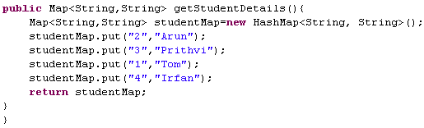
Lend a Hand Solution – Problem Statement 1
Create a class named MapEx. It should loads a map with student registration number as key and student name as value and returns the student map.
Always remember to declare the Map using the appropriate interface. In the example it is Map.

Slide 81
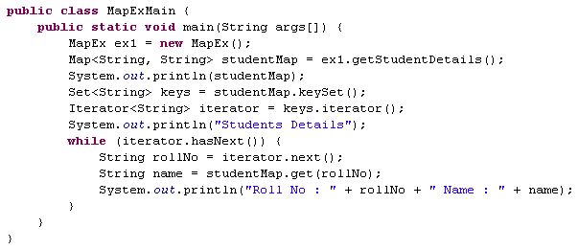
Lend a Hand Solution – Problem Statement 2
Let us now iterate through the map and print the name and the registration number.
Prints the map
Gets the key Set for the map
Gets the iterator for the keyset
Iterates over the key set and reads the value for each key.

Slide 82
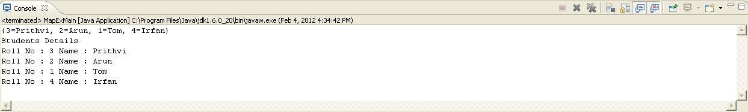
Lend a Hand - Output
What can be done to automatically sort the map according to the registration number ?
The solution is TreeMap, since Tree implements the SortedMap interface, it automatically stores the elements in a sorted order based on the key.

Slide 83
Lend a Hand – TreeMap Demo
In this lend a hand we will see how TreeMap can be used to store elements sorted by the key. We will tweak the previous program to use TreeMap rather than HashMap implementation.
Solution: Change the HashMap to TreeMap in the getStudentDetails() method in MapEx class.
Map<String,String> studentMap=new HashMap<String, String>();
Map<String,String> studentMap=new TreeMap<String, String>();
Note : See how easily we changed the implementation from HashMap to TreeMap by making just one change. This is the advantage of declaring collections with the interface Map.

Slide 84
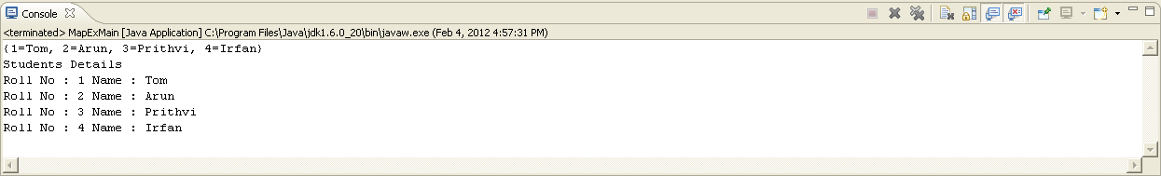
Lend a Hand – TreeMap Output
Notice the output the student records are displayed based on the registration number order.

Slide 85
Time To Reflect
Associates to reflect the following before proceeding.
What types of map can be used to if want to allow null values?
Suppose you are asked to create a telephone directory with person's name in a sorted order which map implementation do you prefer to use ?

Slide 86
How to store user defined objects in collections?
User defined classes can be stored in any of the collections like list , set map etc.
In the next lend a hand we will see how user defined objects can be added and retrieved from an ArrayList. Same procedure applies for all other collections.
NOTE: To add a user defined object to a sorted collection developers should either
Make the User Defined object to implement Comparable interface (or)
Create a custom comparator class and pass it as constructor parameter when creating the collection object.
Refer the following links for more details :
http://docs.oracle.com/javase/1.4.2/docs/api/java/lang/Comparable.html
http://docs.oracle.com/javase/1.3/docs/api/java/util/Comparator.html

Slide 87
Lend a Hand – Adding user defined object in collection
Consider a scenario in which you want to send the details of students to a method. The student details includes roll number , name , address, phone number and email id. Suppose there are 50 students what can be done to pass the details of all the 50 students together ?
Let us see how to solve it?
Step 1 : Create a Student class with the roll number, name , address as it’s fields.
Step 2 : Create an object of Student class for each student and load the details.
Step 3 : Create an ArrayList and add each of the Student objects to the list.
Step 4 : Pass the list as argument to the method.

Slide 88
Lend a Hand – Adding user defined object in collection
Let us create a StudentManager class with method printStudentDetails() accepts the student details as a list of student objects.
Components to be developed:
Student Class : For holding the student details.
StudentManager class : Contains method for printing the student details.
MainClass class : Creates 5 student objects , adds them to a list and pass it to the printStudentDetails() method of the StudentManager class.

Slide 89
Lend a Hand : Create Student class
The Student class should have the following fields to hold the student details
roll number
name
address
phone number
email id
All the fields should be created as private and accessed using public methods.

Slide 90
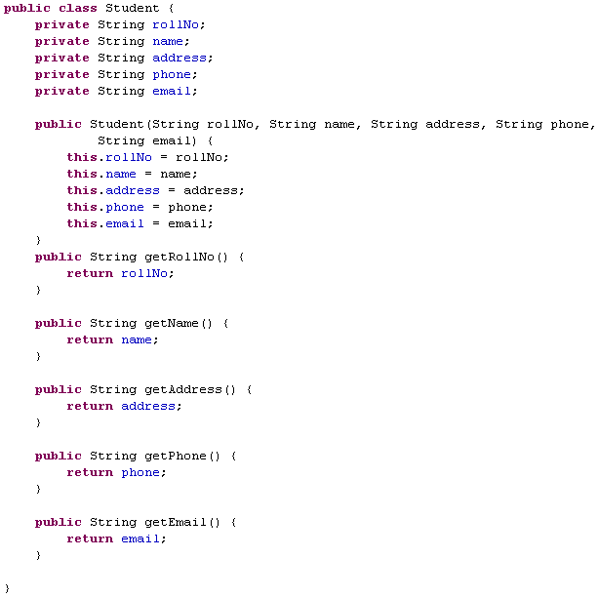
Lend a Hand : Student class Code
All the methods starting with the word “get” are used to read the associated field value.
Example : getName() returns the name.
The values to the member variables can be initialized using the overloaded constructor.

Slide 91
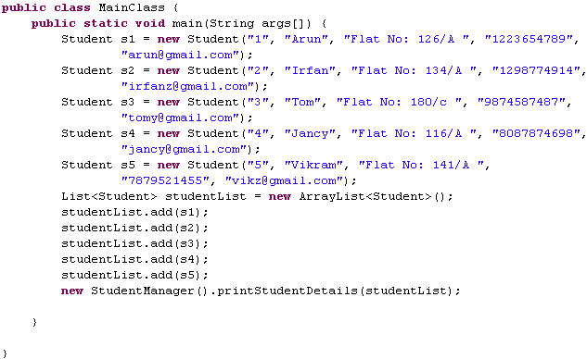
Lend a Hand : Main Class Code
Creates five Student objects
Creates ArrayList objects and adds the student objects to the list.
Passes the list as input to printStudentDetails method

Slide 92
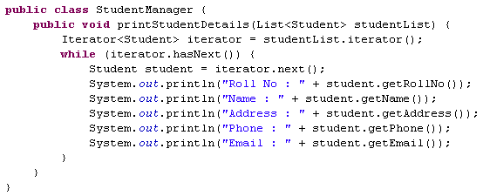
Lend a Hand : Create StudentManager class Code
The printStudentDetails() method accepts list of students as argument.

